Slide 1

PROPELLER DISPLAY
2015-2016
THE M.S.UNIVERSITY OF BARODA

Slide 2

FLOW
PRINCIPLE & INTRODUCTION
HARDWARE REQUIREMENT
BLOCK DIAGRAM
CIRCUIT DIAGRAM
COMPONENT DESCRIPTION
DELAY CALCULATION
PARTS INVOLVES
MAKING
WORKING MODEL
APPLICATION
ADVANTAGES

Slide 3
PRINCIPLE AND INTRODUCTION
Persistence of Vision
Propeller is a term connected with a rotating object: motor or pump.
Propeller rotates a set of LEDs for displaying numbers, characters and symbols in a rotating manner that’s the reason why it is termed as a Propeller LED Display.

Slide 4
HARDWARE REQUIREMENTS
Microcontroller.
Resistors, Capacitors, Diodes.
Transformer, Voltage Regulator.
LEDs, PCB.
High Speed Motor.

Slide 5
Block Diagram
5 Volt DC Regulated
Power Supply
Microcontroller
AT89C2051
Led Display
12V DC Regulated
Power supply
DC Motor

Slide 6
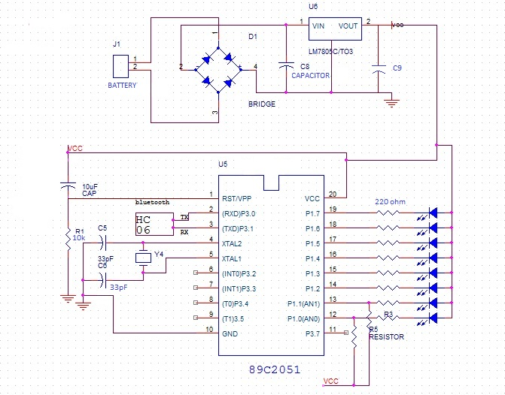
CIRCUIT DIAGRAM

Slide 7
COMPONENT DESCRIPTION
COMPONENT
LEDs | 8
CAPACITOR | 2(33 pF),1(0.1µF,10µF)
BATTERY | 1 (9 V)
VOLTAGE REGULATOR | 1 (7805)
RESISTOR | 8(220Ω)
MICROCONTROLER | AT89C2051
CRYSTAL | 1(11.0952 MHz)
DC MOTOR | 1(1000 rpm)

Slide 8
DELAY CALCULATION
Radius == 15 cm
Perimeter == 2¶ * 15 == 94.24 cm
Total number of letters==17
Total number of column ==17*6== 102
Width of led column == 0.923 cm
Length for a letter == 6 * 0.923 == 5.54 cm

Slide 9
Motor speed == 1000 RPM
Time for one rotation == 60 ms
Time for a letter == 60\17 ==3.52 ms
Column for each letter == 6
Time for a column==3.52/6=0.588 ms==588µs

Slide 10
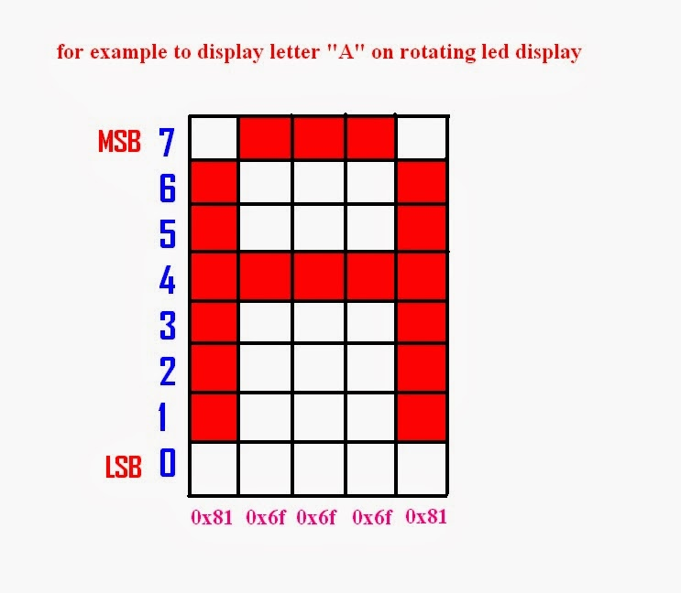

Slide 11
PARTS INVOLVED
The Hardware of Propeller LED Display Involves Two Parts.
Motor driven part
Propeller display part

Slide 12
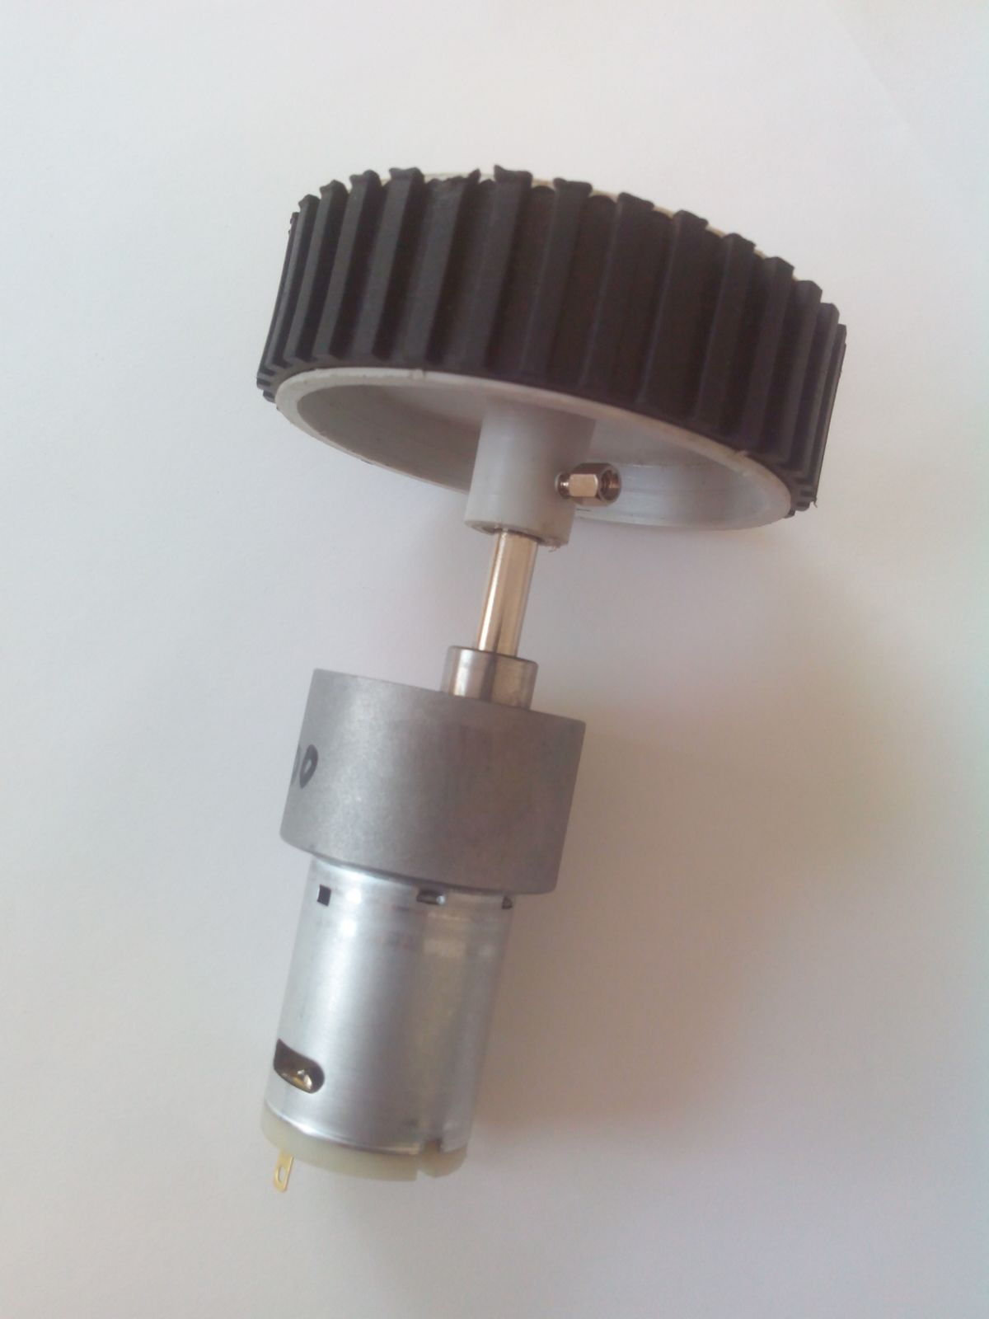
Motor with Supporting Wheel

Slide 13
MOTOR DRIVEN PART
In a motor-driver part, the power from the AC mains is stepped down to a motor-operating range by a step down transformer. Because it is a DC motor, the AC voltage is converted into DC using a bridge-rectifier circuit, and then it is regulated to a motor voltage. For this purpose we have used an adaptor.

Slide 14
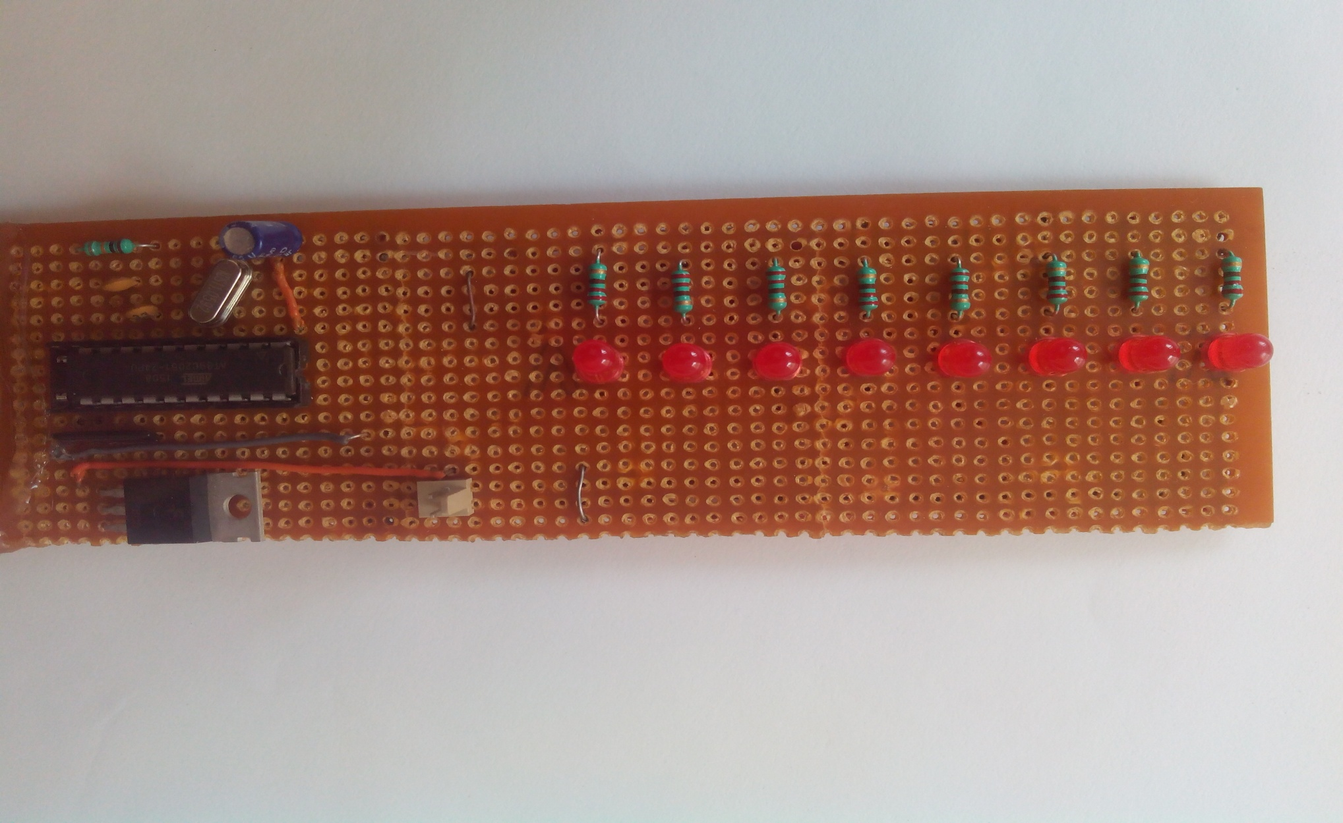
PROPELLER DISPLAY PART

Slide 15
PROPELLER DISPLAY PART
DC power supply is given to the microcontroller, which is programmed, and then the message will be displayed on the rotating object by using a set of LEDs. DC supply given to controller is taken from DC battery.
By this way, the LEDs display the message with the help of a motor driver in a rotating fashion.

Slide 16
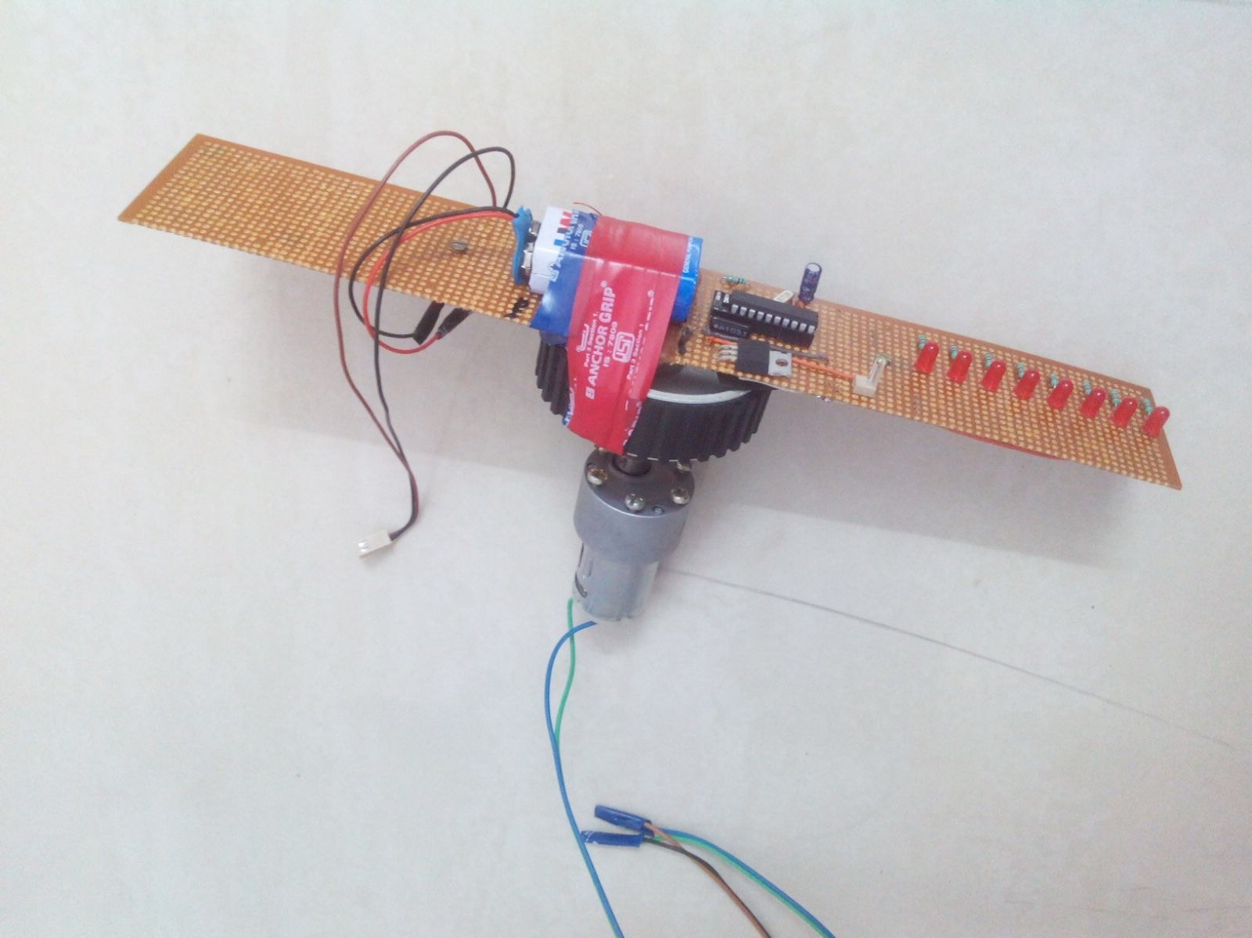
MAKING
The biggest problem was the making of the hardware setup as the whole system had to be a light weight, evenly balanced and yet a strong one. Even slight variation of center of mass from the axle resulted in large scale wobbling of the system.

Slide 17
Programming the microcontroller was not simple either. A lot of experiments were done to get proper display of characters.
We had some soldering practice when we made model of our project.

Slide 18

WORKING MODEL

Slide 19
APPLICATION
Applications can find their way into cost effective solutions for
Large public displays, information systems.
It can directly replace Railway station information displays, bus stands, hospitals, schools, industries and many more places.
This can be used as industrial, commercial and domestic purpose.

Slide 20
ADVANTAGES
Digital scrolling LED display can be replaced by propeller display which has very less number of LEDs used compare to scrolling message system even though it covers same area of display.
Requires less space, less power consumption.
Having low weight, easy to handle.
Attractive display used for advertisement.

Slide 21
WORK TO BE DONE
Adjusting the time delay precisely to have a steady display of characters.
Interfacing of the controller with an android phone via Bluetooth HC06 module.
Making of outer cover and base of the hardware to have a proper look.

Slide 22
FUTURE SCOPE
It Can be Made possible to Display the clock RTC on the Display.
It can be made to have a cylindrical or spherical display as well.
Can be integrated with android phone via Bluetooth.
Display content can be instantly changed by using phone, so the stock market, jewellery showrooms, etc can have reliable displays.

Slide 23
REFERENCES
http://homemaderobo.blogspot.in/2012/03/propellerrotating-led-display.html?m=1
http://www.instructables.com/id/propeller-LED-display/
http://ieeexplore.ieee.org/xpl/articleDetails.jsp?arnumber=6636169&queryText=rotating%20display&newsearch=true
http://ewh.ieee.org/sb/calcutta/jadavpur/Papers/DC1201.pdf
The 8051 Microcontroller And Embedded Systems By M.A.MAZIDI.

Slide 24
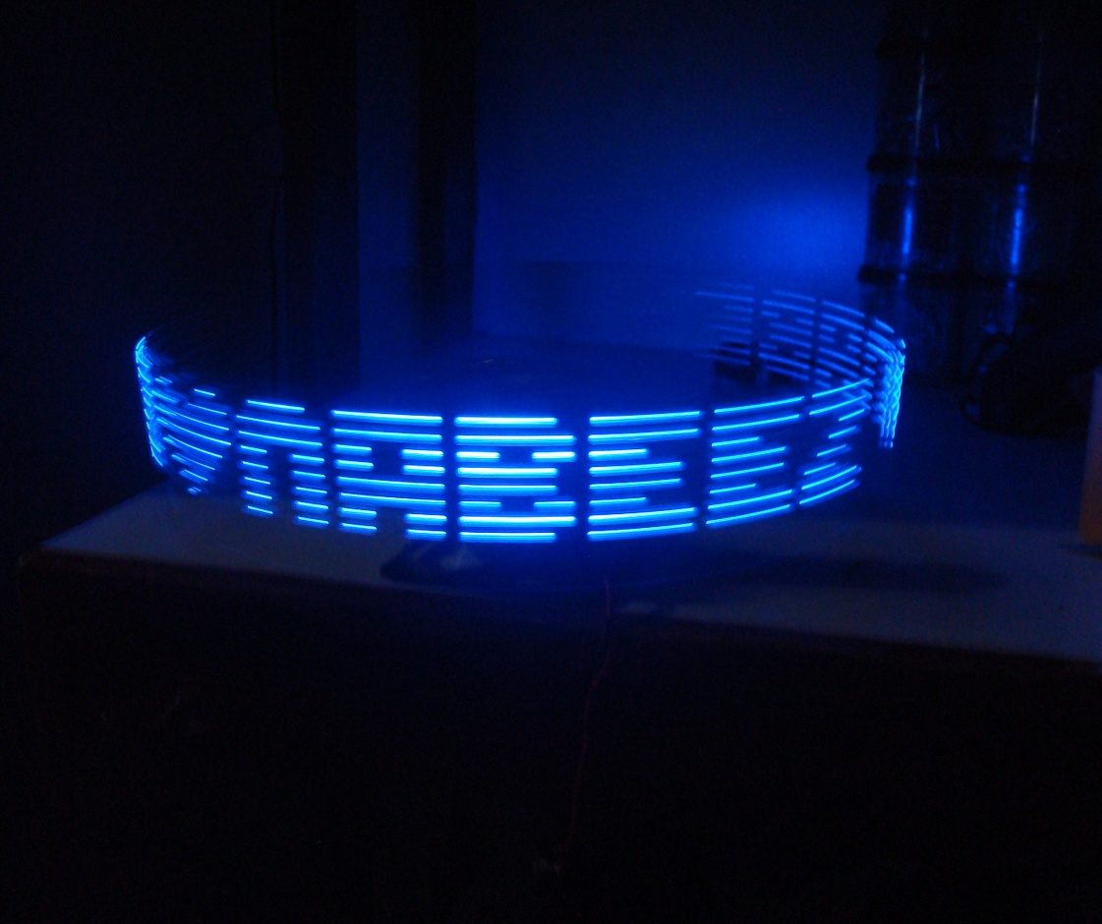
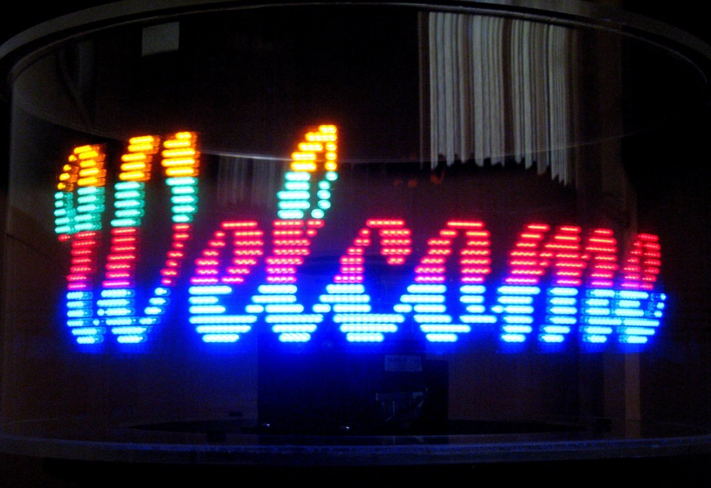

Slide 25
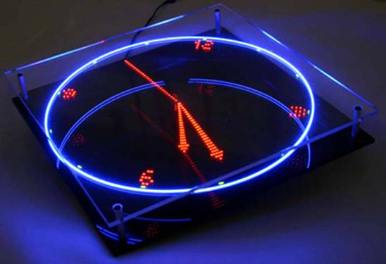

Slide 26
THANK YOU
GUIDED BY: Dr. HIREN SHAH
PROJECT BY: HIRAL MISTRY
HARSH DESAI

